Slide 1
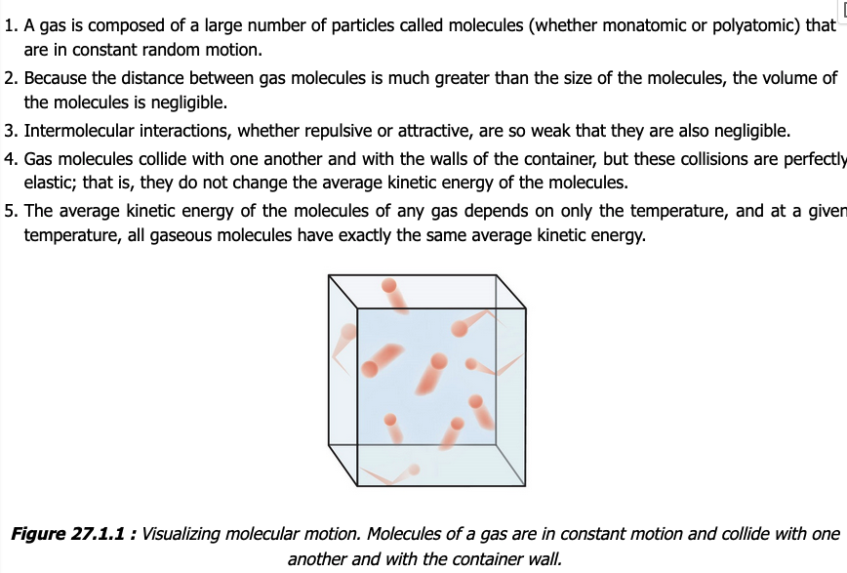
Assumptions of the kinetic-molecular theory of gases

Slide 2
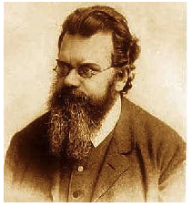
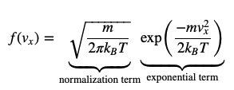
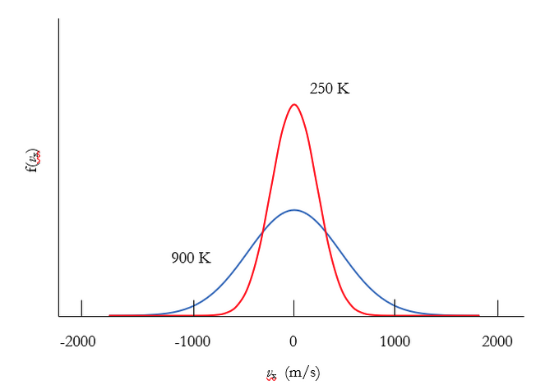


The Boltzmann Distribution (which we’re calling “$f_{B}$”)
Ratios like $\frac{m}{k_{B}}$ are equal to $\frac{M}{R}$
isotherms of $f_{B}\left(v_{x}\right)$ for $H_{2}(g)$

Slide 3
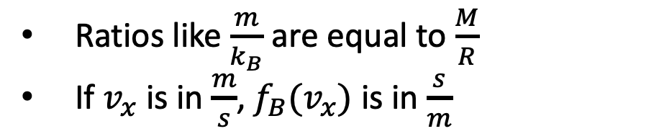


The Boltzmann Distribution (which we’re calling “$f_{B}$”)
Ratios like $\frac{m}{k_{B}}$ are equal to $\frac{M}{R}$
If $v_{x}$ is in $\frac{m}{s}$, $f_{B}(v_{x})$ is in $\frac{s}{m}$
isotherms of $f_{B}\left(v_{x}\right)$ for $H_{2}(g)$
$$\frac{s}{m}$$
$$\frac{m}{s}$$

Slide 4

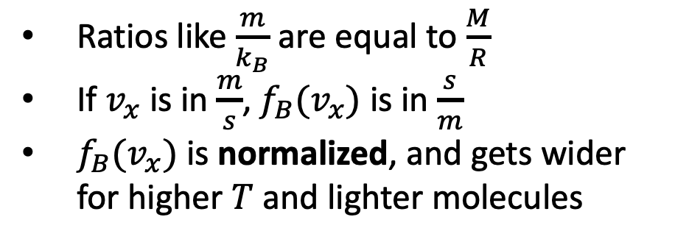
The Boltzmann Distribution (which we’re calling “$f_{B}$”)
Ratios like $\frac{m}{k_{B}}$ are equal to $\frac{M}{R}$
If $v_{x}$ is in $\frac{m}{s}$, $f_{B}(v_{x})$ is in $\frac{s}{m}$
$f_{B}(v_{x})$ is normalized, and gets wider for higher $T$ and lighter molecules
isotherms of $f_{B}\left(v_{x}\right)$ for $H_{2}(g)$
$$\frac{s}{m}$$
$$\frac{m}{s}$$

Slide 5
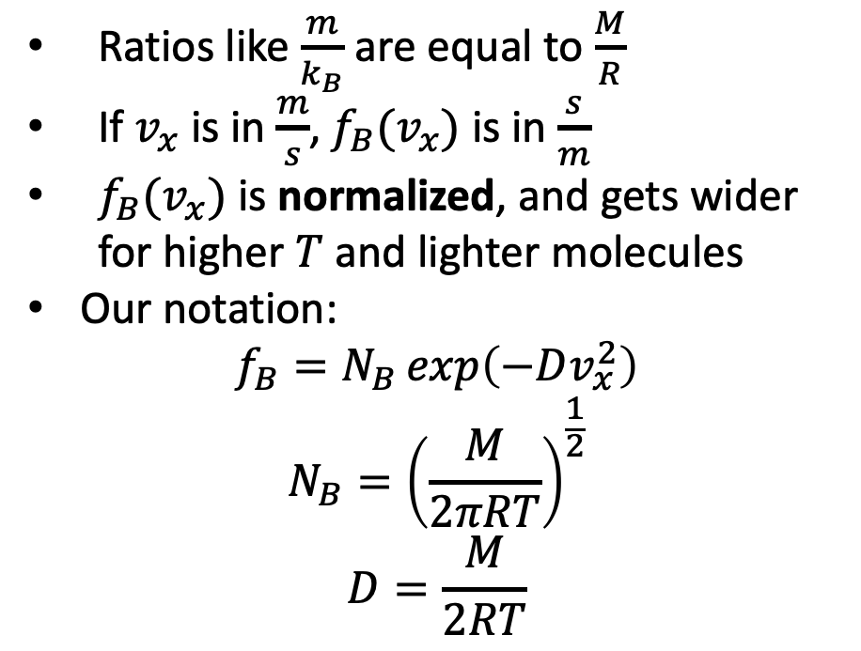
The Boltzmann Distribution (which we’re calling “$f_{B}$”)
Ratios like $\frac{m}{k_{B}}$ are equal to $\frac{M}{R}$
If $v_{x}$ is in $\frac{m}{s}$, $f_{B}(v_{x})$ is in $\frac{s}{m}$
$f_{B}(v_{x})$ is normalized, and gets wider for higher $T$ and lighter molecules
Our notation:
$f_{B}=N_{B}\exp\left(−Dv_{x}^{2}\right)$
$${N_{B}=\left(\frac{M}{2πRT}\right)}^{\frac{1}{2}}$$
$$D=\frac{M}{2RT}$$
isotherms of $f_{B}\left(v_{x}\right)$ for $H_{2}(g)$
$$\frac{s}{m}$$
$$\frac{m}{s}$$

Slide 6
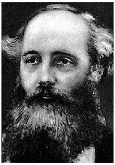

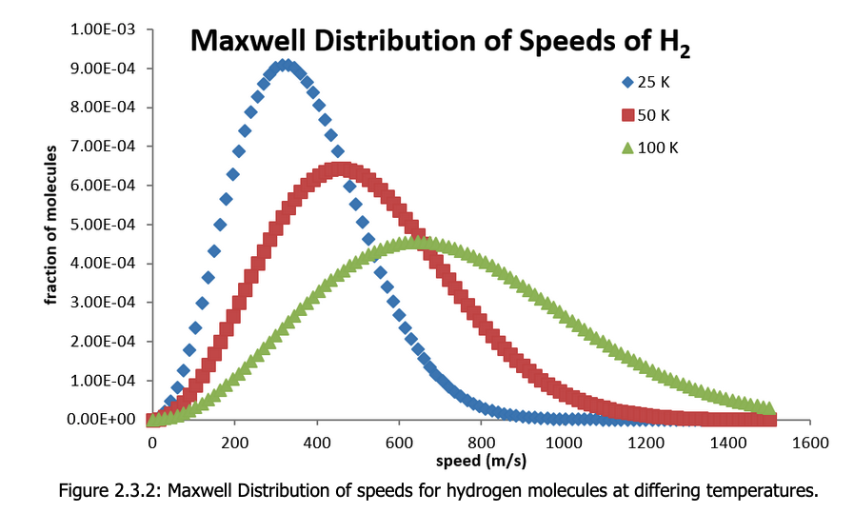



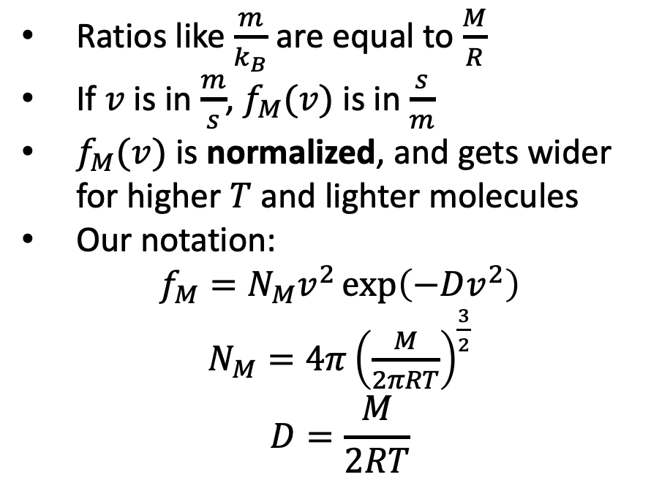

The Maxwell Distribution (which we’re calling “$f_{M}$”)
Ratios like $\frac{m}{k_{B}}$ are equal to $\frac{M}{R}$
If $v$ is in $\frac{m}{s}$, $f_{M}(v)$ is in $\frac{s}{m}$
$f_{M}(v)$ is normalized, and gets wider for higher $T$ and lighter molecules
Our notation:
$$f_{M}=N_{M}v^{2}\exp\left(−Dv^{2}\right)$$
$N_{M}=4π{\left(\frac{M}{2πRT}\right)}^{\frac{3}{2}}$
$$D=\frac{M}{2RT}$$
isotherms of $f_{M}\left(v\right)$ for $H_{2}(g)$
$$\frac{s}{m}$$
$$\frac{m}{s}$$

Slide 7
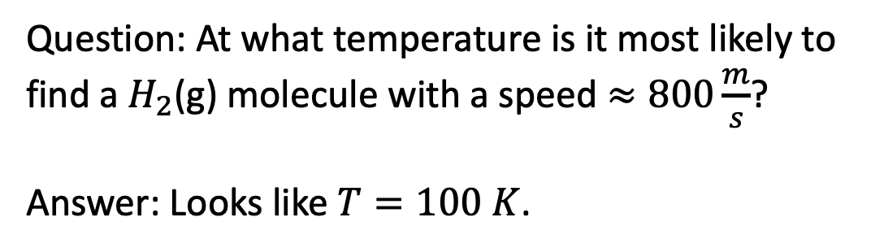
Visual inspection tells us about relative probabilities
isotherms of $f_{M}\left(v\right)$ for $H_{2}(g)$
Question: At what temperature is it most likely to find a $H_{2}$(g) molecule with a speed $≈800\frac{m}{s}$?
Answer: Looks like $T=100 K$.

Slide 8
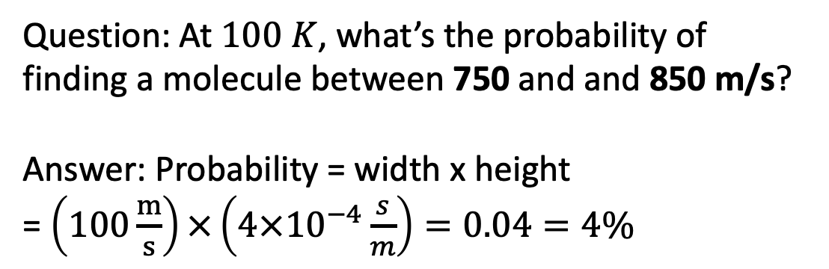

A quick calculation gives us quantitative probabilities
isotherms of $f_{M}\left(v\right)$ for $H_{2}(g)$
Question: At $100 K$, what’s the probability of finding a molecule between 750 and and 850 m/s?
Answer: Probability = width x height
= $\left(100\frac{m}{s}\right)×\left(4×{10}^{−4}\frac{s}{m}\right)=0.04=4\%$
Notes:
25 x 2e-4 x 100 = 0.5%

Slide 9
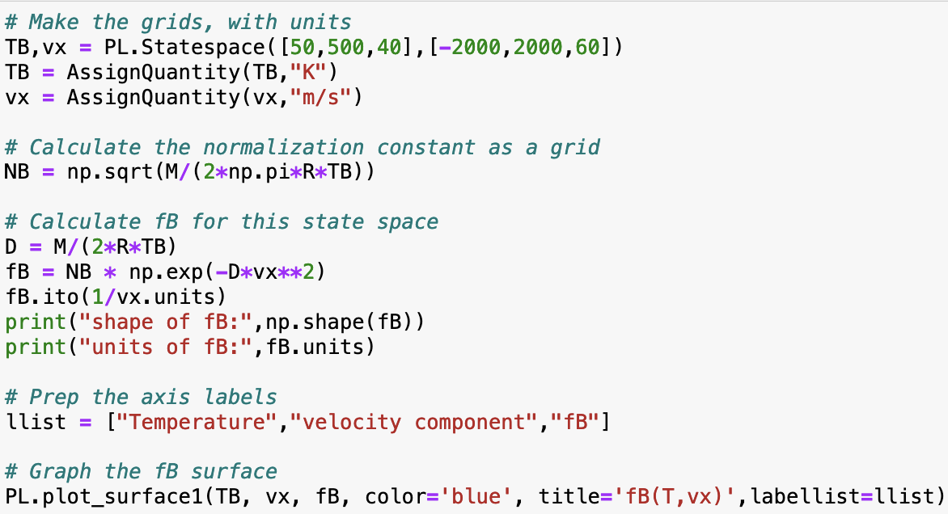
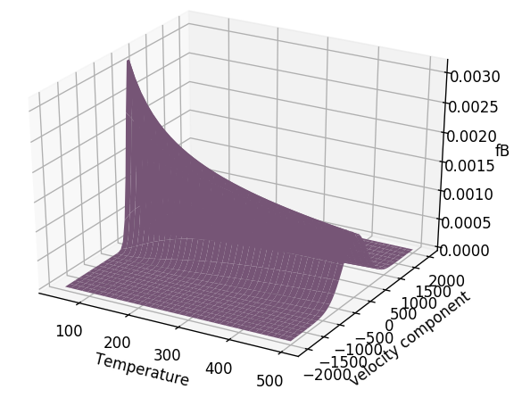
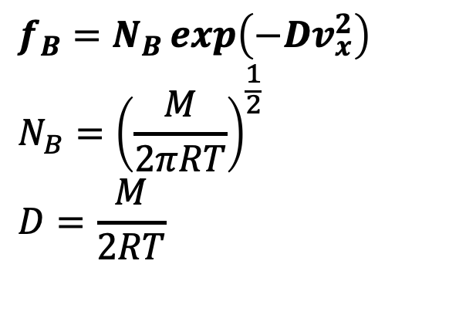
Using Python to visualize $f_{B} (T,v_{x})$
$$f_{B}=N_{B}\exp\left(−Dv_{x}^{2}\right)$$
$${N_{B}=\left(\frac{M}{2πRT}\right)}^{\frac{1}{2}}$$
$$D=\frac{M}{2RT}$$

Slide 10
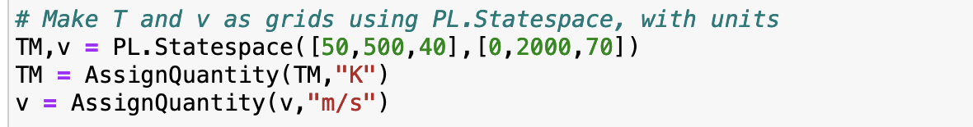
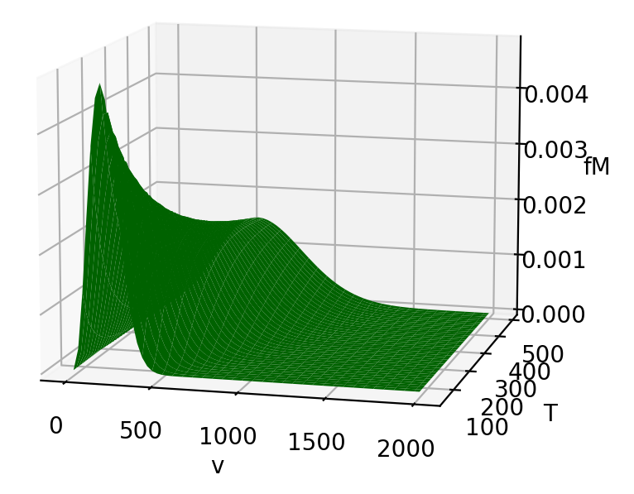
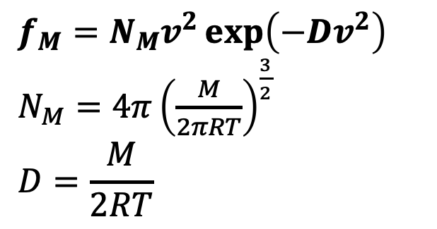
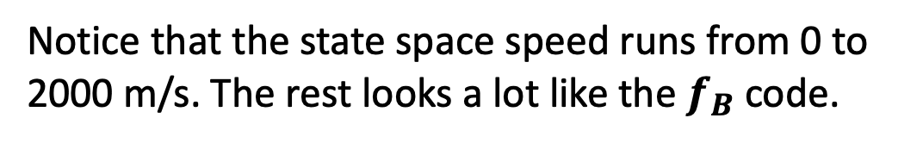
Using Python to visualize $f_{M} (T,v)$
$$f_{M}=N_{M}v^{2}\exp\left(−Dv^{2}\right)$$
$N_{M}=4π{\left(\frac{M}{2πRT}\right)}^{\frac{3}{2}}$
$$D=\frac{M}{2RT}$$
Notice that the state space speed runs from 0 to 2000 m/s. The rest looks a lot like the $f_{B}$ code.

Slide 11
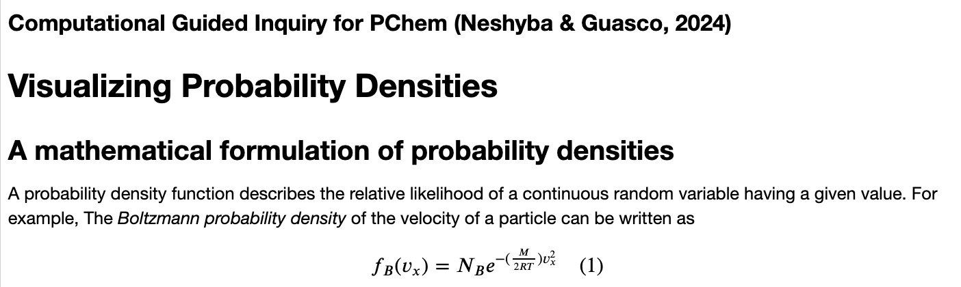
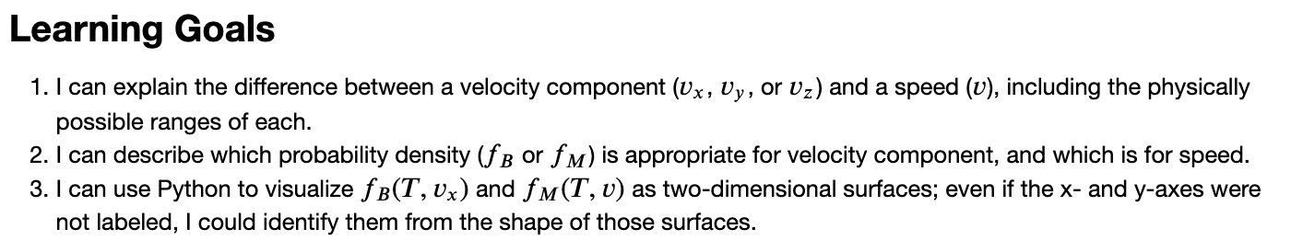
OK, let’s get started

